Slide 1
What Short Rate Model Should I Use?
Colin Turfus
Aurelio Romero-Bermudez
Wilmott Magazine
Aki Lin
Mar 31, 2022

Slide 2
Abstract
Choosing the best short rate model combining analytic tractability with accurate representation of the term structure of interest rate volatility
suggest a new approach which provides approximate but highly accurate analytic bond and option pricing while allowing a trade-off between complexity and goodness-of-fit to the market-observed term structure of smile and skew

Slide 3
Outline
Introduction
Overview of Short Rate Models
Canonical Framework
Functional Forms for the Short Rate
Stochastic Discounting Operators
Numerical Evidence
Conclusions

Slide 4
Introduction
What is the best short rate model to represent interest rates?
What the criteria are to be used in determining ”best”?
Consider a wider range is likely to give rise to a better answer.

Slide 5








Overview of Short Rate Models
Classical Models
generic one-factor dynamics for the short rate
the volatility is an affine function of
[1985] Cox et al.
the volatility is an affine function of
[1978] Dothan
[1990] Hull and White
[1991] Black and Karasinski
[2001] Mercurio and Moraleda

Slide 6
Overview of Short Rate Models
Classical Models
generic one-factor dynamics for the short rate
the volatility is an affine function of
[1985] Cox et al.
the volatility is an affine function of
[1978] Dothan
[1990] Hull and White
[1991] Black and Karasinski
[2001] Mercurio and Moraleda

Slide 7
Overview of Short Rate Models
Hull-White approach
While it was suggested that, in a low rates regime with negative rates possible or even common, there were certain advantages, these had to be weighed against the disadvantage that, in the event that the rates simulated by the model rose significantly, the modelled volatility did not, resulting in poor modelling for OTM call options.
CIR
a hard lower bound for the simulated short rate with the risk of rates getting stuck there for extended periods with the volatility underestimated
the integral of the short rate to be incorporated is not known to be amenable.
Black-Karasinski model
provides a more plausible alternative with volatility automatically rising when the simulated rates move away from zero.
the requirements of a hard minimum value for simulated rates and of the implied normal volatility vanishing as rates approach this minimum.

Slide 8


Overview of Short Rate Models
The Black Shadow Rate Model
allowed rates to become negative
specifying that any rates which were modelled as negative were set to zero
Local Volatility Models
have a more general dependence on rt than the relatively simple (typically affine) assumptions made in the classical models
Stochastic Volatility Models
a stochastic volatility extension to the Hull-White model
Multi-Factor Models
cost of added complexity
facilitates greater flexibility in the taxonomy of shapes which a curve can take on in subsequent evolution, with different parts of the curve moving in different directions at the same time, rather than all forward rates being perfectly correlated as they are in the one-factor case

Slide 9
Canonical Framework
In order to compare and evaluate models, it is useful to introduce a canonical framework which allows the essential features of a model to be seen more transparently.
the dependence of volatility on the short rate.
the dependence of mean reversion on the short rate.
There is clearly never going to be one “best” model: our interest is in making a choice which is optimal against a range of criteria, analytic tractability being salient among them.

Slide 10

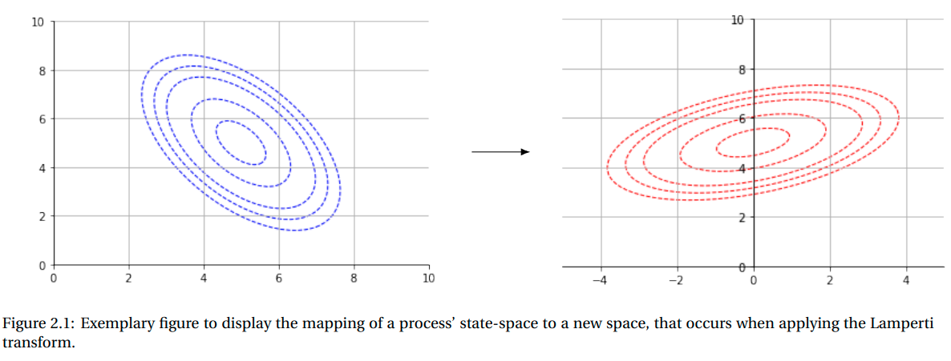
Canonical Framework
In order to compare and evaluate models, it is useful to introduce a canonical framework which allows the essential features of a model to be seen more transparently.
the dependence of volatility on the short rate.
the dependence of mean reversion on the short rate.
To facilitate this exploration
follow Martin et al. [2015] in making use of a Lamperti transform to remove the functional dependence of the volatility on the underlying rate.

Slide 11

Canonical Framework
Applying this process to the classical models, we see the following canonical structure arises:
CIR：

Slide 12

Functional Forms for the Short Rate
We observe that there appears to have been surprisingly little variety in the choices which have been considered (implicitly or explicitly) in the literature for the function
it has analytic bond prices, but the time-dependent coefficients arising in the bond formula are obtained by solving non-linear Ricatti ODEs.
Option prices are then obtained by numerical integration of the payoff function over the Gaussian variable y
not a monotonic function of y, so does not give rise to a bijection between rt and yt

Slide 13

Functional Forms for the Short Rate
The property that rt is bounded above by U and below by L
They provide a means of deriving approximate asymptotic expressions for zero coupon bond prices, valid in the limit of low volatility
lognormal volatilities tend to be high, of the order of 60%, so a low volatility assumption is unlikely to sit well with this important use case.

Slide 14

Functional Forms for the Short Rate
This model is of particular interest since, for different choices of the parameter, it gives rise to a family which contains both the Black-Karasinski and the Hull-White families of models as special cases: the former arising with := 0 and the latter arising in the limit as
approach to 1.
With different values of giving rise to different skewness levels
Horvath et al. [2017] derive highly accurate asymptotic expressions for bond and option prices, subject only to interest rate fluctuations being small in absolute terms; which they invariably are, even in the highest interest rate régimes.

Slide 15



Functional Forms for the Short Rate
if one extends the Hull-White model by introducing a quadratic local volatility distribution
applies a Lamperti transform
Having now three configurable parameters
Although the resultant model does not have exact analytic bond and option solutions, it is possible to derive using the methods expounded by Turfus [2021a] highly accurate asymptotic representations, valid subject only to the constraint that again rate fluctuations are not high.

Slide 16




Functional Forms for the Short Rate
Turfus and Romero-Bermúdez [2021]
equal but with opposite signs.
This would give rise to an additional degree of freedom, facilitating different limiting smile levels for low and high rates, with almost no concomitant increase in model complexity

Slide 17





Stochastic Discounting Operators
We therefore look now at the way in which solutions for the canonical short rate model specified by (3.3) and (4.6) can be obtained systematically
To this end we introduce the idea of stochastic discounting operators and use them to obtain pricing formulae for one model as perturbations of those for another.
backward Kolmogorov equation
In seeking approximate analytic solutions, the trick is, in the first instance, to follow Hagan et al. [2015] in writing

Slide 18






Stochastic Discounting Operators
gives rise to a well-known integral kernel with a convenient analytic representation
is small in the sense that its evolution operator (as defined below) can be expressed as a rapidly convergent series
The integral kernel or Green’s function has the property that

Slide 19
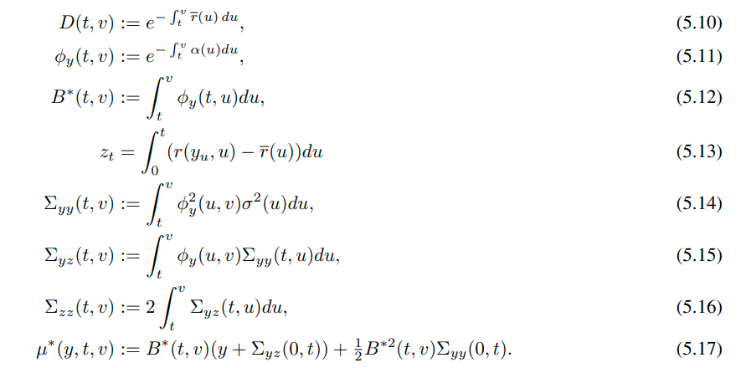
Stochastic Discounting Operators
gives rise to a well-known integral kernel with a convenient analytic representation
is small in the sense that its evolution operator (as defined below) can be expressed as a rapidly convergent series
Notation

Slide 20




Stochastic Discounting Operators
Hull-White
For the Hull-White model we have
In this case the time-ordered exponential can be calculated and applied

Slide 21

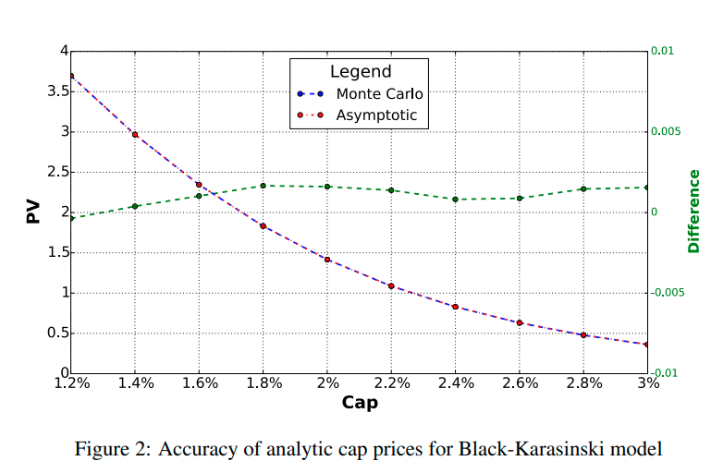

Stochastic Discounting Operators
Black-Karasinski
we have

Slide 22


Stochastic Discounting Operators
Sinh Model

Slide 23
Stochastic Discounting Operators
Beta Blend
Multi-Exponential Model
Composite Kernel
Compounded Rates Kernel
Hybrid Kernels

Slide 24
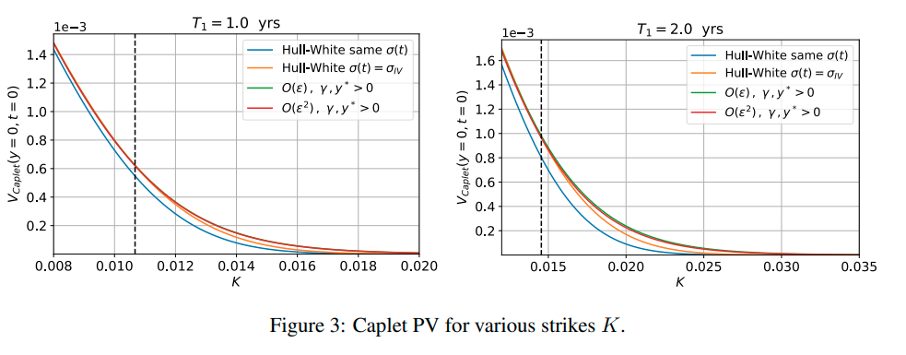
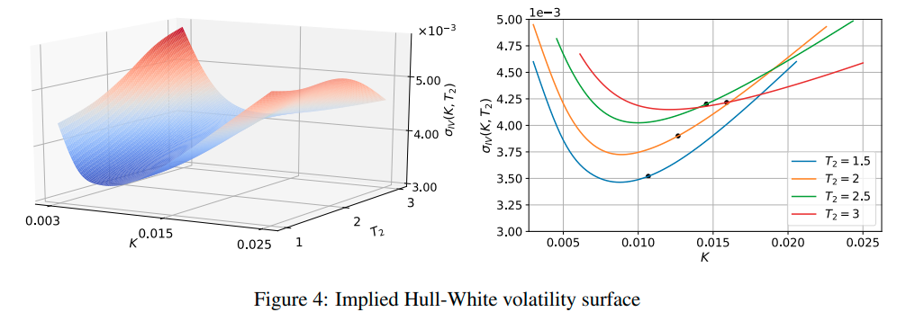
Numerical Evidence

Slide 25

Conclusions
We then turned our attention to some more recent models which give the ability potentially to fit the term structure of volatility smile and skew while preserving tractable analytic approximations (involving only quadratures) for bond and option prices.
a more fruitful way forward to explore alternative short rate models is to represent the short rate as a function of a mean-reverting Gaussian variable

Slide 26
Thanks!
Aki Lin
Mar 31, 2022

